Slide 1
Knowledge Organiser: Is Death the End?
Keywords
1. Afterlife | The life after death
2. Sceptic | Someone who is doubtful about something
3. Empirical evidence | Evidence from an experiment which can be repeated to get the same result again and again
4. Reincarnation | The belief spirits can be reborn as new living beings
5. Heaven | the place where God lives and where good people go after they die according to some religions
6. Hell | A place of misery and suffering. It is where evil people go after they die according to some religions
7. Karma | good or bad luck, viewed as resulting from one's actions.
8. Soul | a spiritual part of a person which we cannot see, which is said to exist after death
Christian Beliefs about the Afterlife
Christians believe that humans are created ‘in God’s image’ and that this spirit or soul is a reflection of this image inside every person.
In Christianity, it is believed that the spirit enables humans to communicate with God through prayer and worship.
Many Christians believe it is the spirit that will live on after death. Christians believe that there will be a Judgement Day and that on this day the bodies of the dead will rise and be made ‘perfect’ again. The bodies and the spirits of the believers will go to heaven.
Islamic Beliefs about the Afterlife
Muslims believe that human beings are Allah’s highest creation because they are the only living things to have a soul. They believe that Allah gives each human an individual soul soon after the baby begins to develop in the mother’s womb.
Muslims believe that life is a test and an opportunity to do good. They believe that good acts will be rewarded in the afterlife by the soul joining Allah in paradise, but evil acts will be punished.
When a Muslim dies, their soul is judged on what they have done in their life and how well they have followed Allah’s guidance, for example, if they have asked forgiveness for sins and followed Muslim duties such as prayer and helping others.

Slide 2
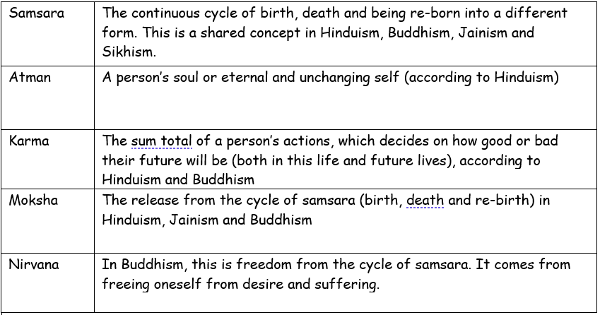
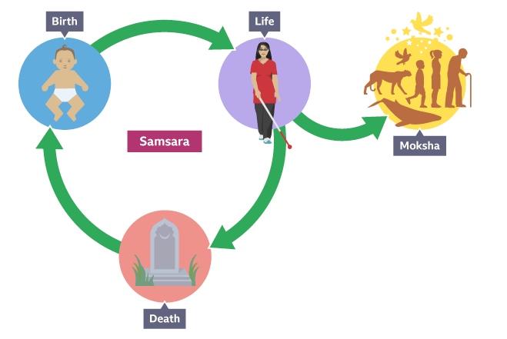
Reincarnation
For and Against Arguments for Life After Death
We can never prove that there is a life after death, but equally we can never prove that there isn’t a life after death. So why can’t there be? | Some people claim to have ‘spoken’ to the dead. Perhaps psychic people / fortune tellers.
Life Support Machines prove that the brain actually dies before the body. So then it is just organs being kept alive by medicine and machines. | Throughout history, so many people have experienced or felt spirits and ghosts. It is too many people to all be wrong about the same belief. They can’t all be talking nonsense.
Near-death experiences – people who have been resuscitated say that whilst they were medically ‘dead’ they were travelling through a tunnel or towards a light. | It is written in the Bible that Jesus died on the cross, but was resurrected (came back from the dead). In the Bible people claim to have seen Jesus and saw the holes in his hands and feet from the crucifixion.
Thousands of people believe in religions such as Sikhism and Buddhism which agree that every living thing has a soul which survives after death of the body. | People invented the idea of life after death just to give them some comfort and hope when they lose loved ones. It’s just a myth.
You can see a body physically rot and decay, so we know that only a skeleton is left. Surely there is nothing else. | The end of life means exactly that, it is illogical to speak of a life after a death.
No one has actually returned from the dead to tell us that there is a life after, and provided evidence for this. | There are many things that as humans we can’t see including atoms, love, electricity, hope, dreams, time, etc… yet we know they exist. So why can’t souls / spirits exist too?

