Slide 1
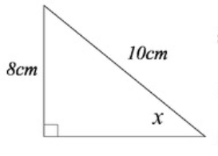
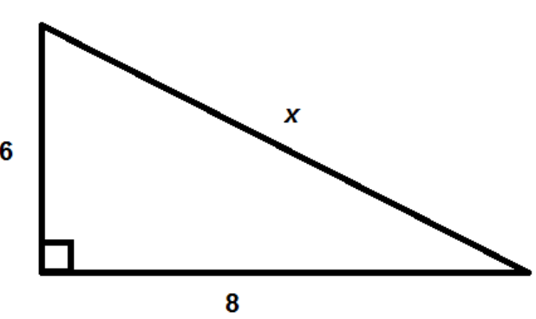
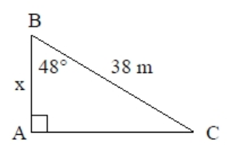
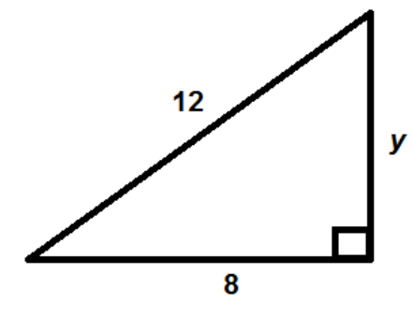

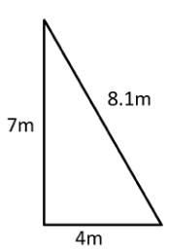
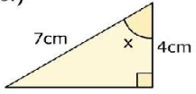
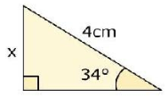
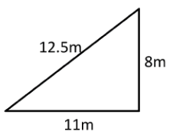





PYTHAGORAS AND TRIGONOMETRY
Key Concepts
Pythagoras’ theorem and basic trigonometry both work with right angled triangles.
Pythagoras’ Theorem – used to find a missing length when two sides are known
$$a^{2}+b^{2}=c^{2}$$
c is always the hypotenuse (the longest side)
Basic trigonometry SOHCAHTOA – used to find a missing side or an angle
When finding the missing angle we must press SHIFT on our calculators first.
Examples
Pythagoras’ Theorem
O
8
$$a^{2}+b^{2}=c^{2}$$
$$6^{2}+8^{2}=x^{2}$$
$100=x^{2}$
$\sqrt{100}=x$
$10=x$
H
S
H
Sinx
10
O
$$\sin{x}=\frac{8}{10}$$
$$x=\sin^{−1}\left(\frac{8}{10}\right)$$
$$x={53.1}^{o}$$
A
x
$$a^{2}+b^{2}=c^{2}$$
$$a^{2}+8^{2}={12}^{2}$$
$a^{2}={12}^{2}$-${ 8}^{2}$
$a^{2}=80$
$a=\sqrt{80}$
$a=8.9$
C
H
38
Cos48
O
A
O
$$\cos{48}=\frac{x}{38}$$
$$38×\cos{48}=x$$
$$x=25.4m$$
H
S
H
C
H
T
A
A
Key Words
Right angled triangle
Hypotenuse
Opposite
Adjacent
Sine
Cosine
Tangent
a) b) c) d)
Find the value of x.
x
498-499, 509-515
x
ANSWERS: a) 8.06m b) 5.94m c) 55.15º d) 2.34cm

Slide 2
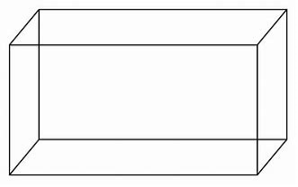


3D TRIGONOMETRY
Key Concepts
Examples
F
H
F
H
E
G
Calculate the length BD:
E
G
B
$${BD}^{2}={12}^{2}+5^{2}$$
6cm
5cm
$$BD=\sqrt{169}$$
B
B
C
$$BD=13cm$$
C
5cm
A
12cm
D
A
D
A
12cm
D
The plane of a cuboid is a
flat 2 dimensional surface.
An example of a plane is ABCD.
An example of a diagonal in a cuboid is FD.
Calculate the angle between FD and the plane ABCD:
Calculate the length FD:
F
$${FD}^{2}={13}^{2}+6^{2}$$
F
$$tanθ=\frac{6}{13}$$
6cm
$$FD=\sqrt{205}$$
6cm
$$θ=\tan^{−1}\left(\frac{6}{13}\right)$$
$$FD=14.32cm$$
θ
B
13cm
D
B
13cm
D
$$θ={24.78}^{o}$$
Key Words
Sine
Cosine
Tangent
3D
Plane
Diagonal
F
G
H
E
Calculate the length AC
Calculate the length AH
Calculate the angle between AH and the plane ABCD.
505-507
7cm
B
C
4cm
A
10cm
D
ANSWERS 1) 10.77cm 2) 12.84cm 3) 33.02º

Slide 3





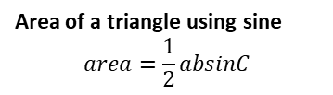














THE SINE AND COSINE RULE
Key Concepts
Examples
Sine rule
To calculate a missing side:
$$\frac{x}{sin35}=\frac{7}{sin42}$$
$$a^{2}=b^{2}+c^{2}−2bccosA$$
xcm
42º
4cm
42º
$$x^{2}=4^{2}+{7.5}^{2}−2×4×7.5×cos42$$
$$\frac{a}{sinA}=\frac{b}{sinB}=\frac{c}{sinC}$$
$$x=\frac{sin35×7}{sin42}$$
7.5cm
$$x^{2}=27.66$$
To calculate a missing angle:
7cm
35º
$$x=6.0cm$$
xcm
$$x=\sqrt{27.66 }=5.26cm$$
$$\frac{sinA}{a}=\frac{sinB}{b}=\frac{sinC}{c}$$
xº
$$cosA=\frac{4^{2}+{7.5}^{2}−8^{2}}{2×4×7.5}$$
Cosine rule
To calculate a missing side:
$$\frac{sinx}{4}=\frac{sin42}{7}$$
4cm
7.5cm
4cm
42º
$$A=\cos^{−1}\left(\frac{4^{2}+{7.5}^{2}−8^{2}}{2×4×7.5}\right)$$
$$a^{2}=b^{2}+c^{2}−2bccosA$$
$$sinx=\frac{sin42×4}{7}$$
To calculate a missing angle:
8cm
$$A={82.1}^{o}$$
$$cosA=\frac{b^{2}+c^{2}−a^{2}}{2bc}$$
7cm
xº
$$x=\sin^{−1}\left(\frac{sin42×4}{7}\right)$$
4cm
50º
$$area=\frac{1}{2}×4×7.5×sin50$$
Area of a triangle using sine
$$area=\frac{1}{2}absinC$$
$$x={22.5}^{o}$$
7.5cm
$$area=11.49{cm}^{2}$$
Key Words
Sine
Cosine
Side
Angle
Inverse
2D
5cm
26º
8.5cm
1a) Calculate x
b) Calculate the area of
the triangle
5cm
2a) Calculate x
b) Calculate the area of
the triangle
320-330, 516-519, 531-533
8.5cm
xº
26º
xcm

