Slide 1
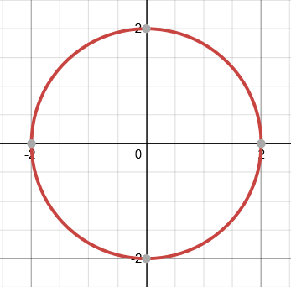

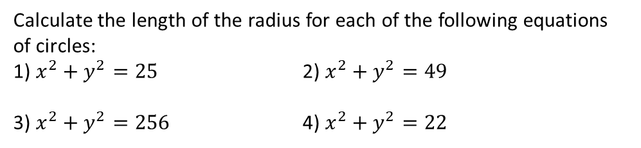



Year 10 Higher
EQUATION OF A CIRCLE
Key Concepts
Examples
The equation of a circle will be in the format:
$$x^{2}+y^{2}=4$$
$$Radius= \sqrt{4}$$
$=±2$
$$x^{2}+y^{2}={radius}^{2}$$
radius
The centre of each circle will be at the coordinate (0,0).
Therefore we can plot the following coordinates to support us sketching our graph: (0,2), (0,-2), (2,0), (-2,0)
Key Words
Radius
Centre
Sketch
Square root
Calculate the length of the radius for each of the following equations of circles:
1) $x^{2}+y^{2}=25$ 2) $x^{2}+y^{2}=49$
3) $x^{2}+y^{2}=256$ 4) $x^{2}+y^{2}=22$
314
ANSWER 1) 5 2) 7 3) 16 4) $\sqrt{22}$

Slide 2
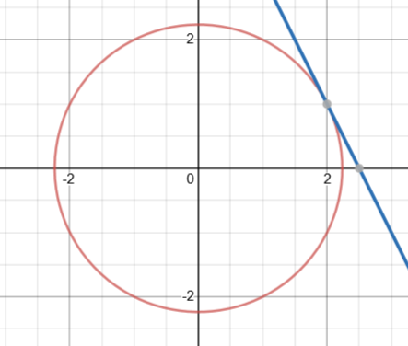
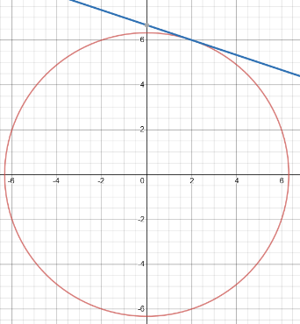
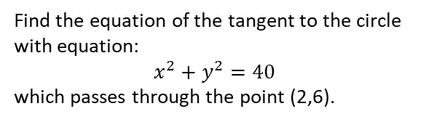


Year 10 Higher
TANGENT TO A CIRCLE
Key Concepts
Examples
A tangent touches a circle at one point.
A tangent line is perpendicular to the radius of the circle.
The gradient of the tangent is the negative reciprocal of the gradient of the equation of the line of the radius.
1) Find the equation of the line which is the radius of the circle.
$$gradient= \frac{1}{2} therefore y=\frac{1}{2}x$$
2) The tangent is perpendicular to the radius.
$$gradient of tangent=negative reciprocal of \frac{1}{2}$$
$$=−2$$
3) Substitute in the given coordinate (2,1) to $y=−2x+c$
$$y=−2x+c$$
$$1=\left(−2×2\right)+c$$
$$1+4=c$$
$$5=c$$
$$y=−2x+5$$
radius
Find the equation of the tangent to the circle with equation:
$x^{2}+y^{2}=5$
which passes through the point (2,1).
Key Words
Radius
Tangent
Negative reciprocal
Perpendicular
Gradient
Find the equation of the tangent to the circle with equation:
$x^{2}+y^{2}=40$
which passes through the point (2,6).
320
ANSWER $y=−\frac{1}{3}x+\frac{20}{3}$

