Slide 1
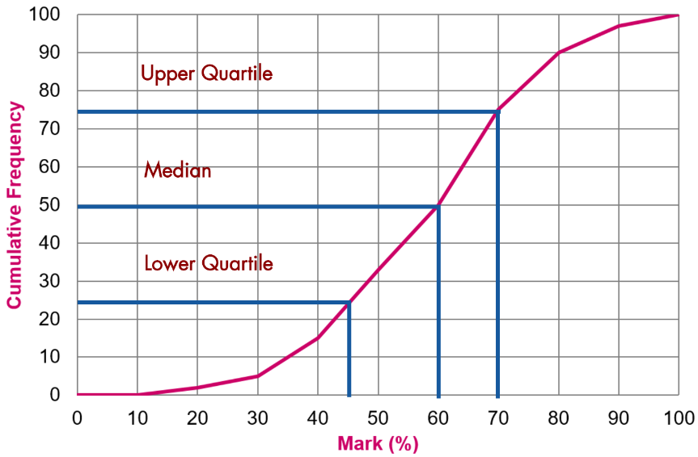
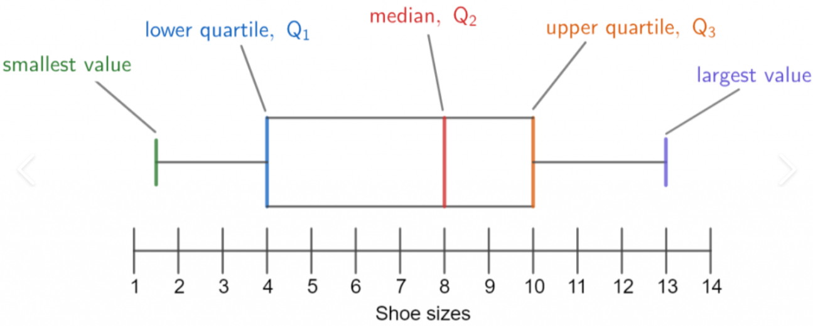

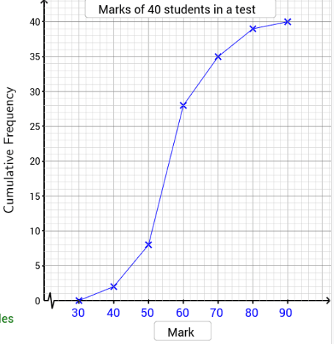
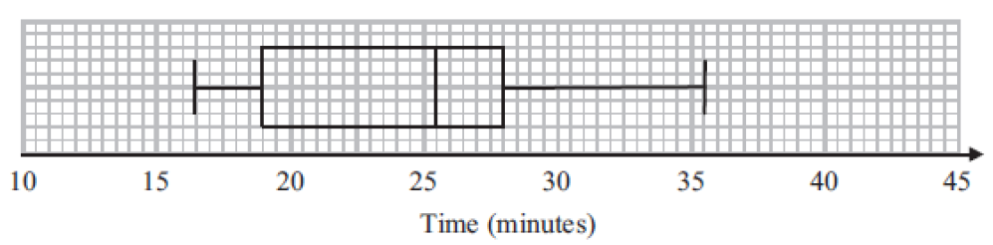
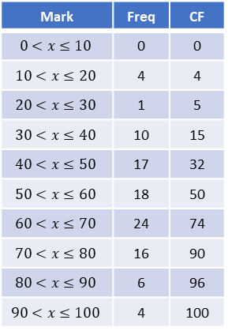
Year 10 Higher
CUMULATIVE FREQUENCY AND BOX PLOTS
Key Concepts
Mark | Freq | CF
$$0<x≤10$$ | 0 | 0
$$10<x≤20$$ | 4 | 4
$$20<x≤30$$ | 1 | 5
$$30<x≤40$$ | 10 | 15
$$40<x≤50$$ | 17 | 32
$$50<x≤60$$ | 18 | 50
$$60<x≤70$$ | 24 | 74
$$70<x≤80$$ | 16 | 90
$$80<x≤90$$ | 6 | 96
$$90<x≤100$$ | 4 | 100
Examples
A cumulative frequency graph shows a running total of frequency.
We can read the median and the interquartile range from this graph.
A box plot shows the distribution of data using minimum, maximum, median and quartiles.
Median and quartiles are found from the y axis:
Lower quartile = 25% of the way through the data
= 45
Median = 50% of the way through the data
= 60
Upper quartile = 75% of the way through the data
= 70
Interquartile range = UQ – LQ
= 70 – 45
= 25
Interquartile range
Range
Plot at the upper bound
Key Words
Cumulative frequency
Box plot
Range
Interquartile range
Median
Quartiles
Minimum/maximum values
1) Read from the cumulative frequency graph to find the median and the interquartile range.
2) Read from the box plot the median, range and interquartile range.
434-440
ANSWERS: 1) Median = 56, Interquartile range = 64 – 52 = 12 2) Median = 26,
Range = 35.5 – 16.5 = 19, Interquartile range = 28 – 19 = 9

Slide 2
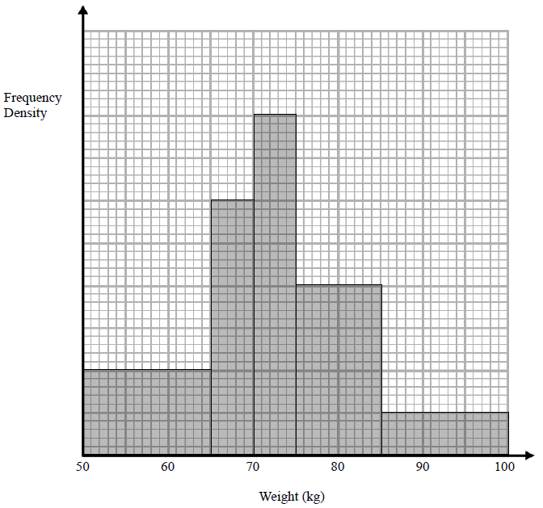
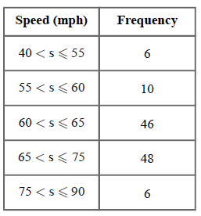
Year 10 Higher
HISTOGRAMS
Key Concepts
Example
A group of people are weighed and their results recorded. Below is their data.
A histogram is used to represent this data.
A Histogram is a graphical representation of data consisting of rectangles whose area is proportional to the frequency of a variable and whose width is equal to the group width.
8
Weight | Frequency | Frequency density
50 < w ≤ 65 | 30 | 30 ÷ 15 = 2
65 < w ≤ 70 | 30 | 30 ÷ 5 = 6
70 < w ≤ 75 | 40 | 40 ÷ 5 = 8
75 < w ≤ 85 | 40 | 40 ÷ 10 = 4
85 < w ≤ 100 | 15 | 15 ÷ 15 = 1
6
Frequency
4
Frequency
density
Group
width
2
F
FD
GW
Key Words
Histogram
Frequency density
Group width
Median
Calculate the frequency density for this table of information.
On a separate set of axes, draw your histogram.
443-449
ANSWERS: Frequency densities = 0.4, 2, 9.2, 4.8, 0.4

