Slide 1
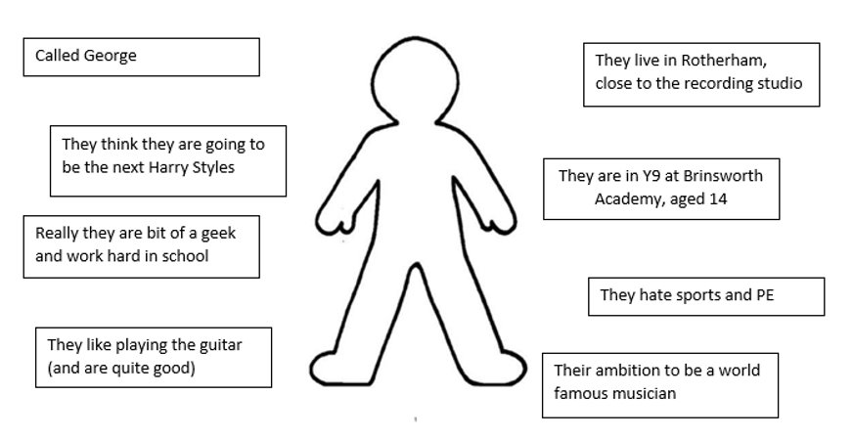
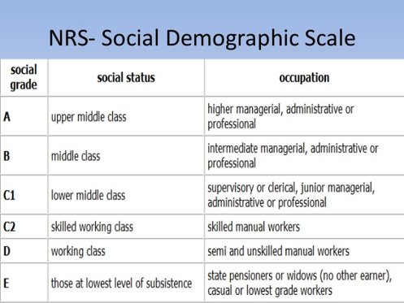
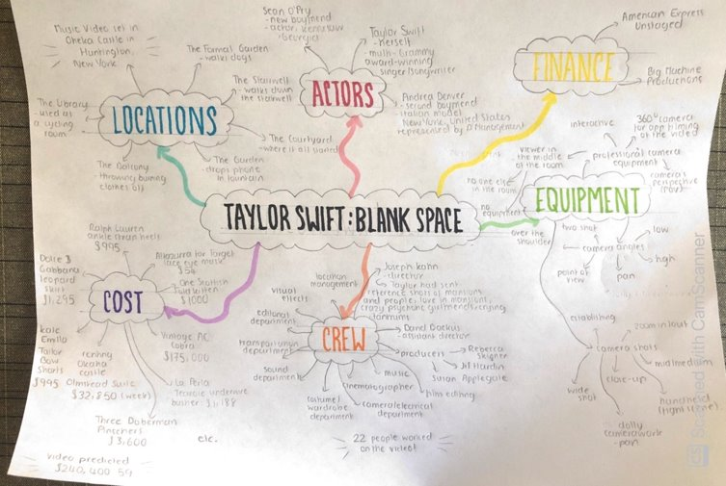
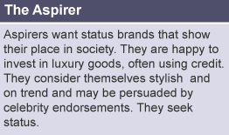
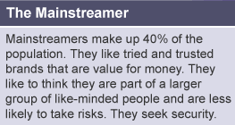
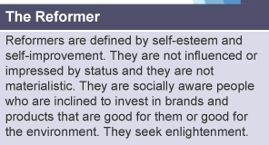
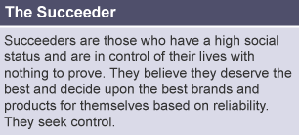
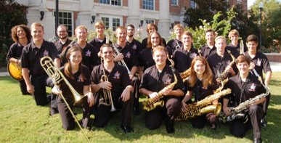
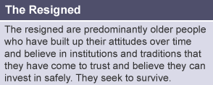
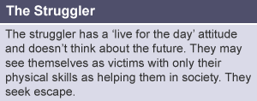
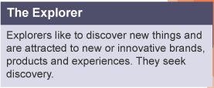
Knowledge Organiser: Component 3
Creating a Media Product in Response to a Brief.
PhotoShop Video Tutorials:
PhotoShop Tutorial 1
Modes of Address:
Direct mode of address - The model looks directly at the audience, or the writing speaks to ‘you’.
Indirect mode of address - The model looks away, or the writing refers to ‘people’ or ‘the public’.
Formal mode of address - Using formal phrasing and terminology.
Informal mode of address - Using more conversational language and slang.
Friendly mode of address - The tone is optimistic and comforting.
Hostile mode of address - The text challenges or insults the reader.
Humorous mode of address - The writer/presenter is trying to make you laugh. The tone could be sarcastic or ironic.
Serious mode of address - The writer/presenter wants you to take their point seriously. The tone would be sincere
IDEAS LOG
An IDEAS LOG is exactly what it sound like – it is a LOG of your IDEAS which describes the media product you will create.
you MUST talk about your target audience and how you are going to make your product appealing to that audience
Target Audience
Primary - the core group of people that you try to reach and are most likely to purchase your products or services.
Secondary - the group of people who are the second most likely to purchase your products and services.
Pen Portrait Example:
PhotoShop Tutorial 2
PhotoShop Tutorial 3
Mind Map Example:
Target Audience
Socio-economic groupings
Age
Gender
Ethnicity
Psychometric Groups
Ethnicity
A group of people that have a common background or culture, whether through hobbies/interests, job, race, religion or language
Psychometrics

