Slide 1
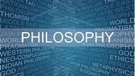
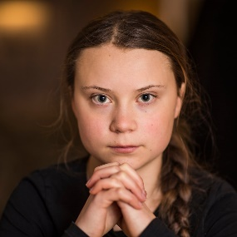
Y8 Summer Term 1 – What inspires and motivates me? Religion and Worldviews
Keyword​​ | Definition​​
Inspiration | The process of being mentally stimulated to do or feel something.
Motivation​​ | A reason or reasons for acting or behaving in a particular way.
Activist | A person who campaigns to bring about political or social change.
Who are inspirational people that I know?
What 3 things do you want to change about the world?
Lesson fact file – summarise the 3 inspirational people that you learn about:
Idea 1 | Idea 2 | Idea 3

