Slide 1
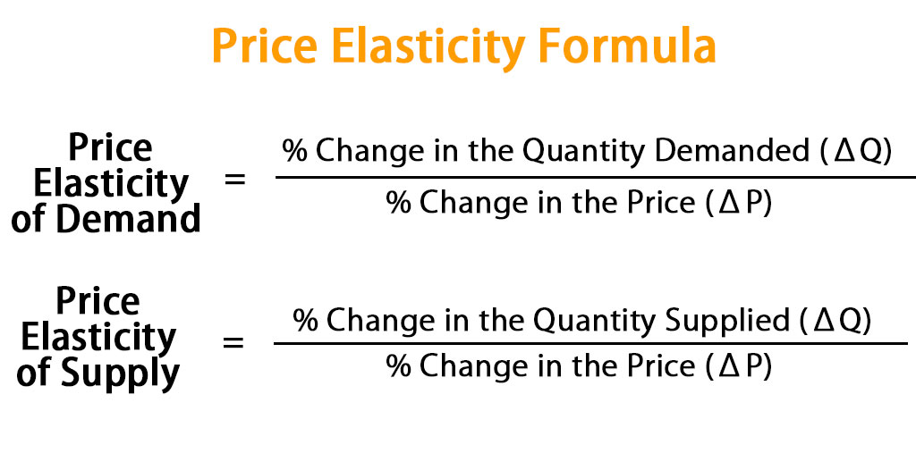
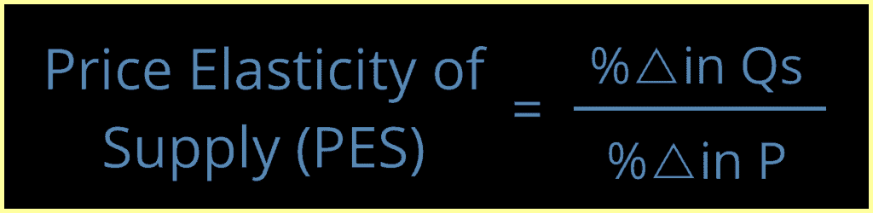
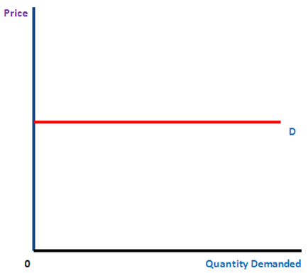
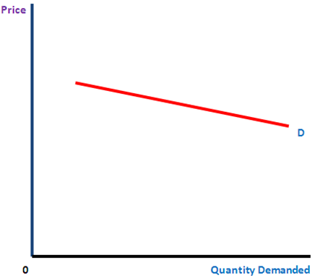
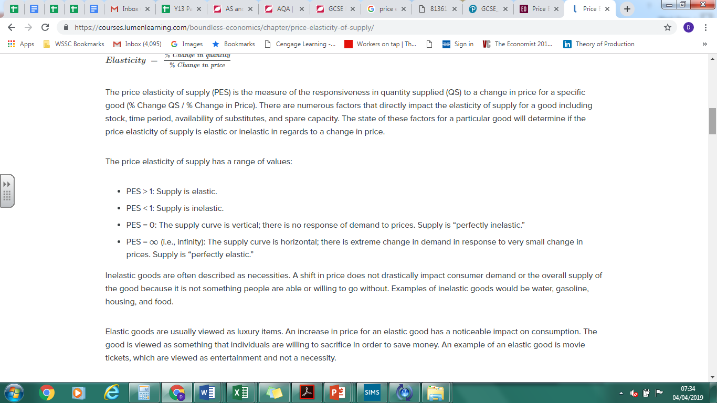
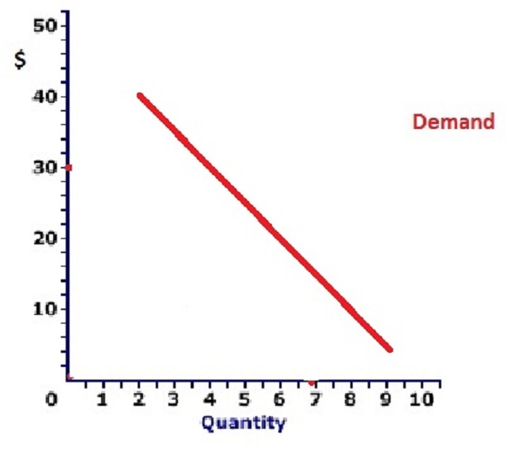
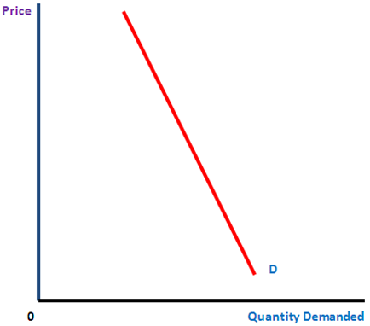
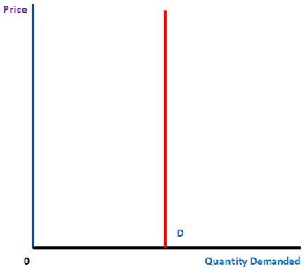
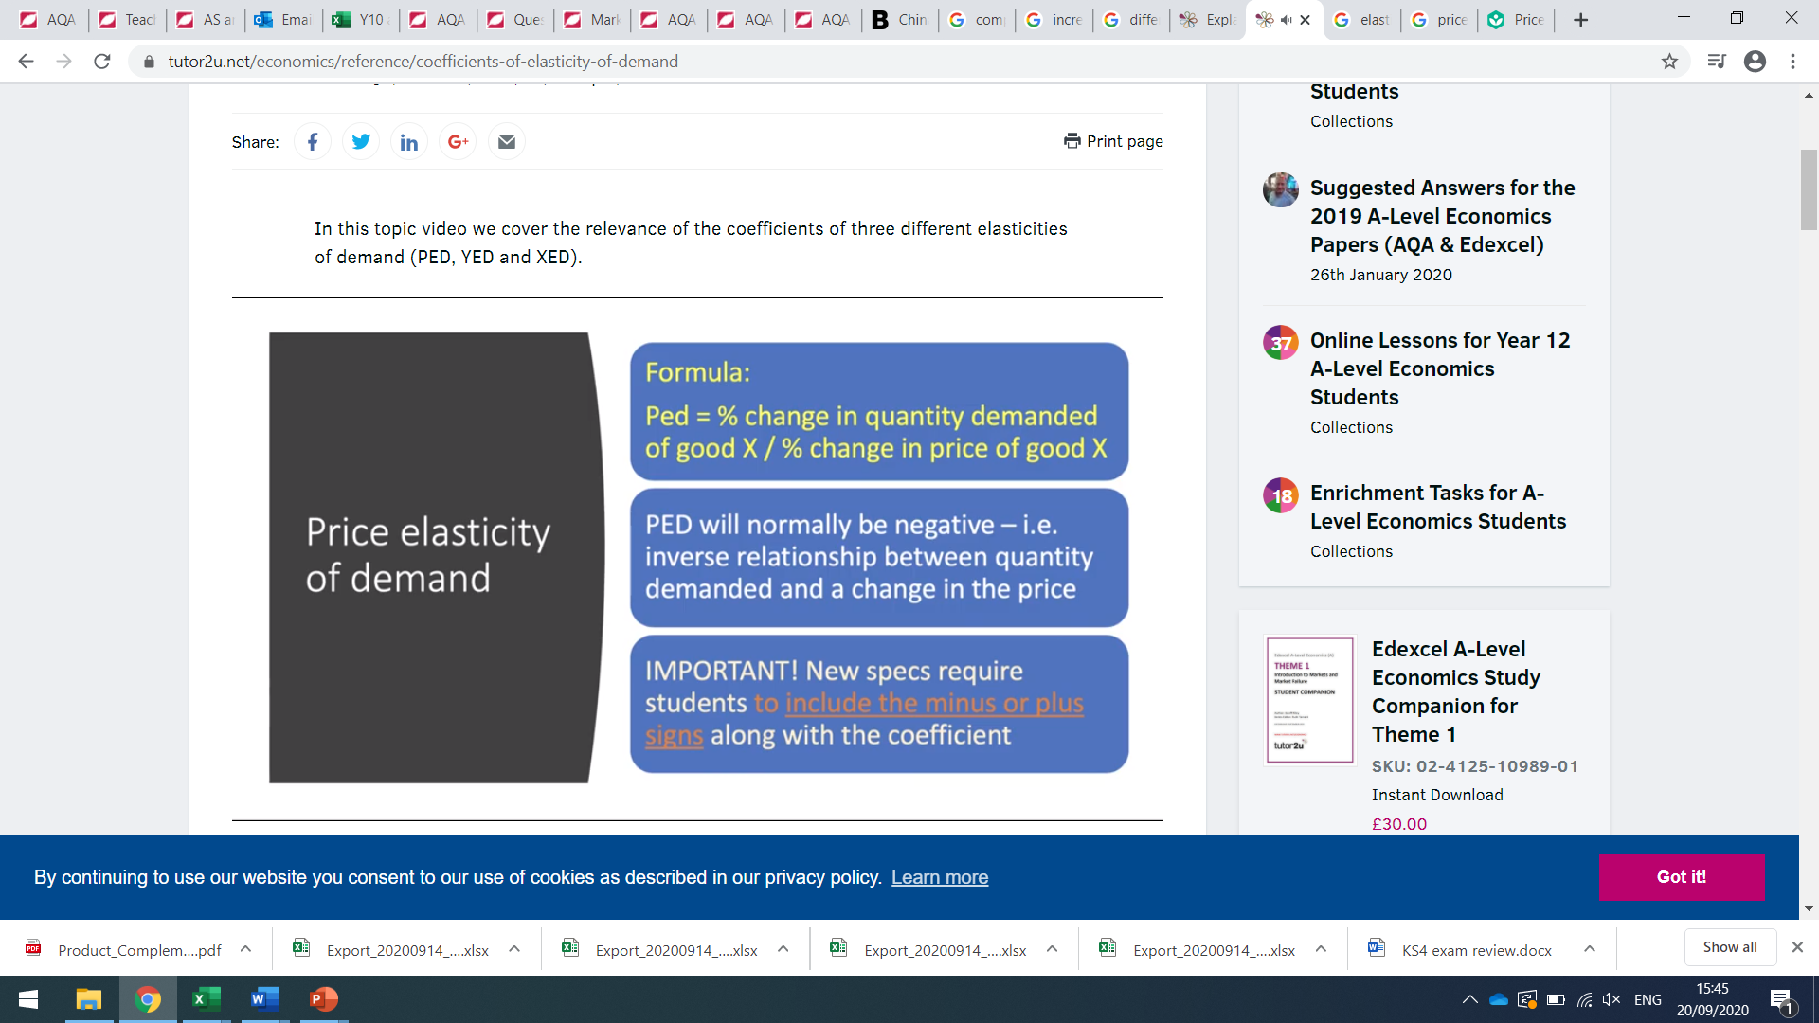
PED
PES
Price elasticity of demand measures the responsiveness of demand after a change in a product's price.
Price elasticity of supply (PES) measures the responsiveness of quantity supplied to a change in price.
It is necessary for a firm to know how quickly, and effectively, it can respond to changing market conditions, especially to price changes.
PED has a formula…. This allows us to calculate just how responsive quantity demanded is to changes in price.
HT6
PED/PES
Price elasticity of demand
Factors affecting price elasticity of demand
Measuring price elasticity of demand
Price elasticity of supply
Factors affecting price elasticity of supply
Measuring price elasticity of supply
-∞ Perfectly elastic
Between -1 and infinity Elastic
Factors affecting demand
Price of substitutes
Price of compliments
Income
Advertising
Fashion/tastes
Uncertainty over future
Competition
Factors affecting Price Elasticity of Supply
Availability of resources: If the economy already using most of its scarce resources then firms will find it difficult to employ more and so output will not be able to rise. The supply of most of goods and services will therefore be price inelastic.
Number of producers: More producers mean that the output can be increased more easily. Thus supply is more elastic.
-1 Unitary elasticity
Between 0 and -1
Inelastic
Increase in cost of production as compared to output: In cases where there is a significant increase in cost of production when output is increased, supply is inelastic. This is because suppliers will have to have to do a significant investment in order to increase the output. It will take time and some suppliers may be hesitant in doing so.
Improvement in Technology: In industries where there is a rapid improvement in technology, the PES of such goods will be more elastic as compared to industries where there is not much improvement in technology.
Stock of finished goods: In industries where there are high inventories/stocks of finished goods, the suppliers can easily supply more as the price rises. Thus, the PES for these goods will be elastic
0 Perfectly inelastic

