Slide 1
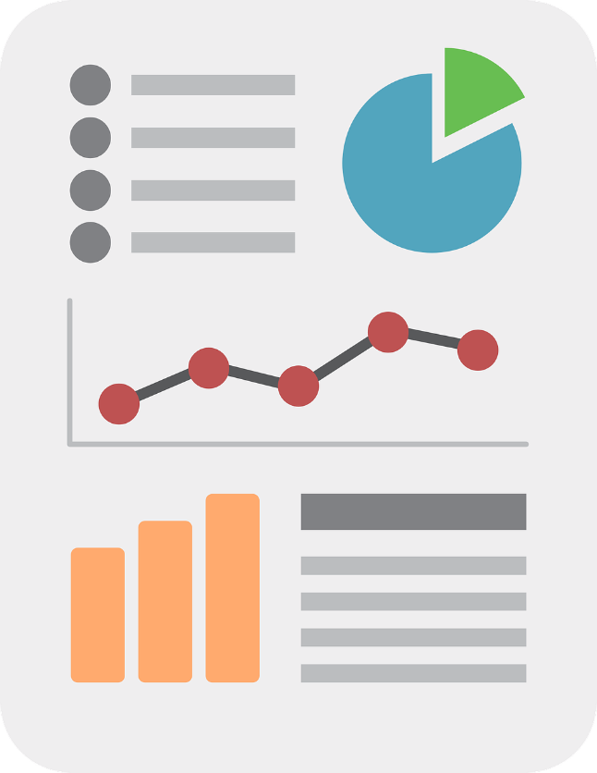
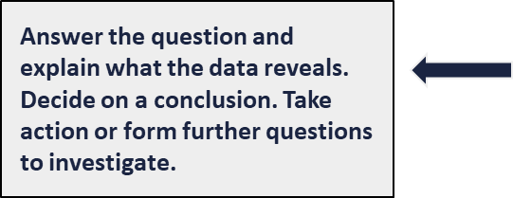
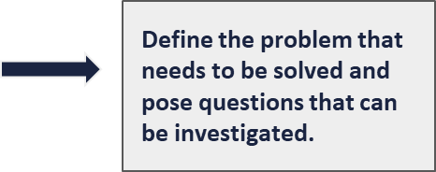
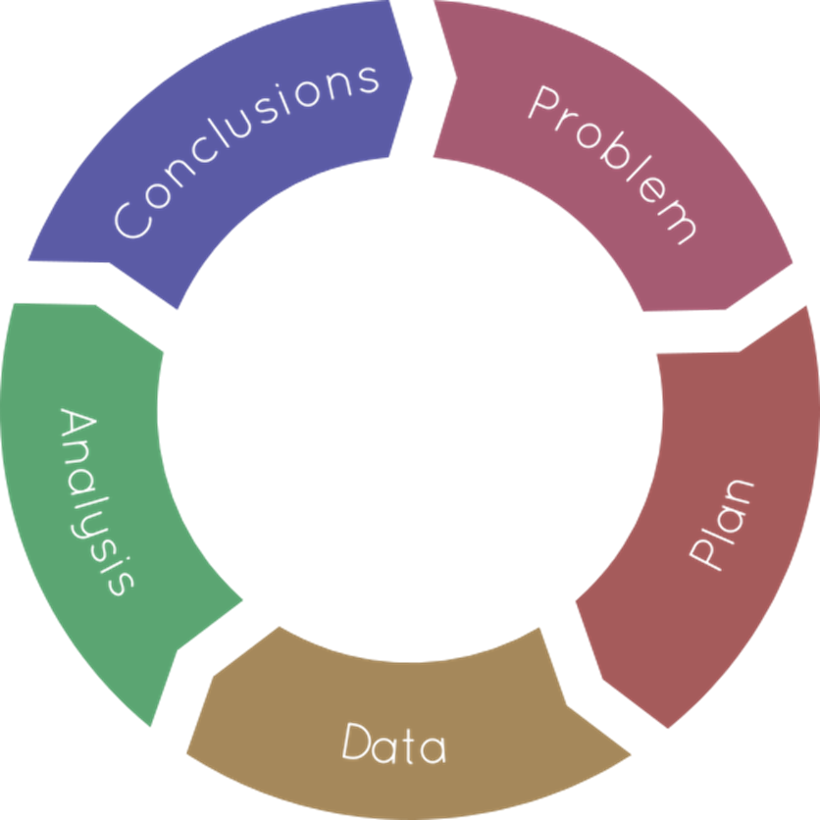
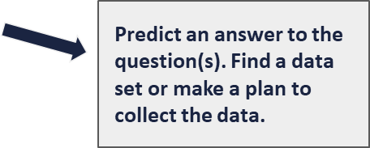
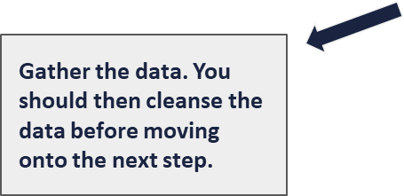
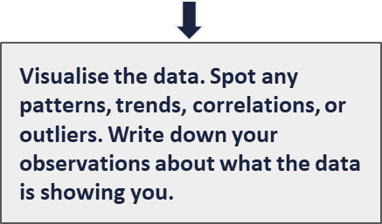
Knowledge Organiser: Data Science
The PPDAC cycle is a framework for us to follow when asking and answering real-world problems using data.
Data Visualisations.
are visual representation of data (such as charts and graphs) intended to help an audience process the information more easily and get a clear idea about the data at a glance.
What is Data Science?
Data science is extracting meaning from large data sets in order to gain insights to support decision-making.
Infographics.
are visual representations of data, often involving pictures that reflect patterns and help tell a story.
Infographics can include visualisations.
Correlation.
A correlation shows that there is a relationship between two or more variables, but that doesn’t guarantee that one causes the other.
Data that sits outside a trend is known an outlier.
Outliers can cause problems when working out statistics such as the mean, but they shouldn’t be removed from the data set without investigating the reason for them.

