Slide 1

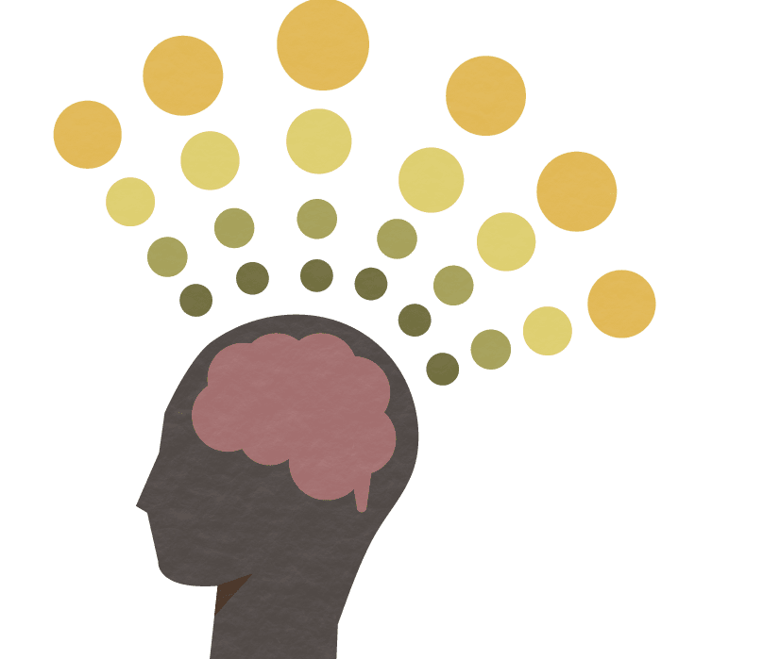

Key words | Definition
Empiricism | The theory that all knowledge is based on experience and information gathered through the senses.
Rationalism | The theory that reason (thinking things through) rather than experience is how we gain knowledge.
Atheism | Non-belief in the existence of God or gods
Evolution | A process of gradual change that takes place over many generations, during which species of animals, plants, or insects slowly change some of their physical characteristics.
The First Cause argument | The belief that everything must have a cause, including the universe and that must be God.
The Design argument | The belief that the world is so complicated and detailed that someone must have designed it, and that must be God.
Revelation | The way in which God makes himself known to people.
Creationist | A person who believes that the universe and all life was created by God in 6 days.
Psychologist | A person who studies the human mind, emotions and behaviour.
'Opium of the People' | Karl Marx’s belief that Religion is like a drug for people, making them feel better about or able to ignore the bad things they experience.
Humanist | A person who does not believe in God but does believe that life is important and special and that we should work to improve society.
Fallacy | A mistaken belief, especially one based on unsound arguments
Religion and Worldviews
Y8 Philosophy Knowledge Organiser
What is Philosophy?
This is about thinking. It is about finding out how and whether things make sense. It deals with questions of morality and ethics. It takes seriously the nature of reality, knowledge and existence.
Philosophers ask questions, difficult, challenging questions. Things such as:
How do I know I'm not dreaming?​
What makes me, me?​
Is there a God?​
Is there such thing as truth?​

Slide 2
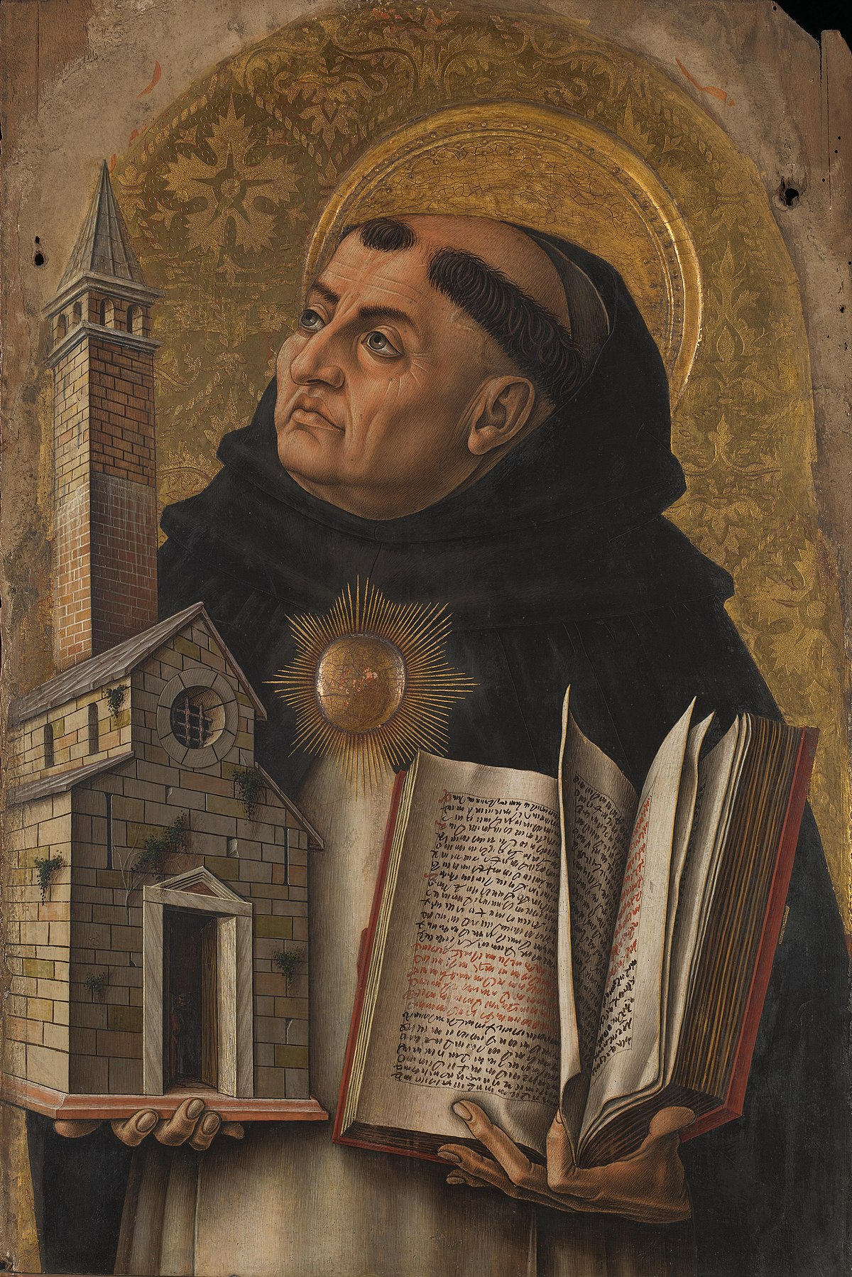
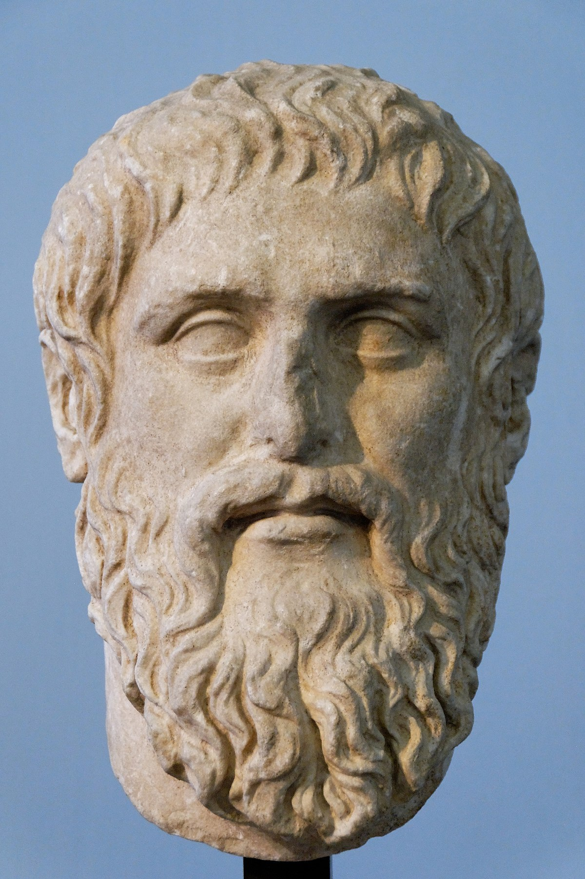

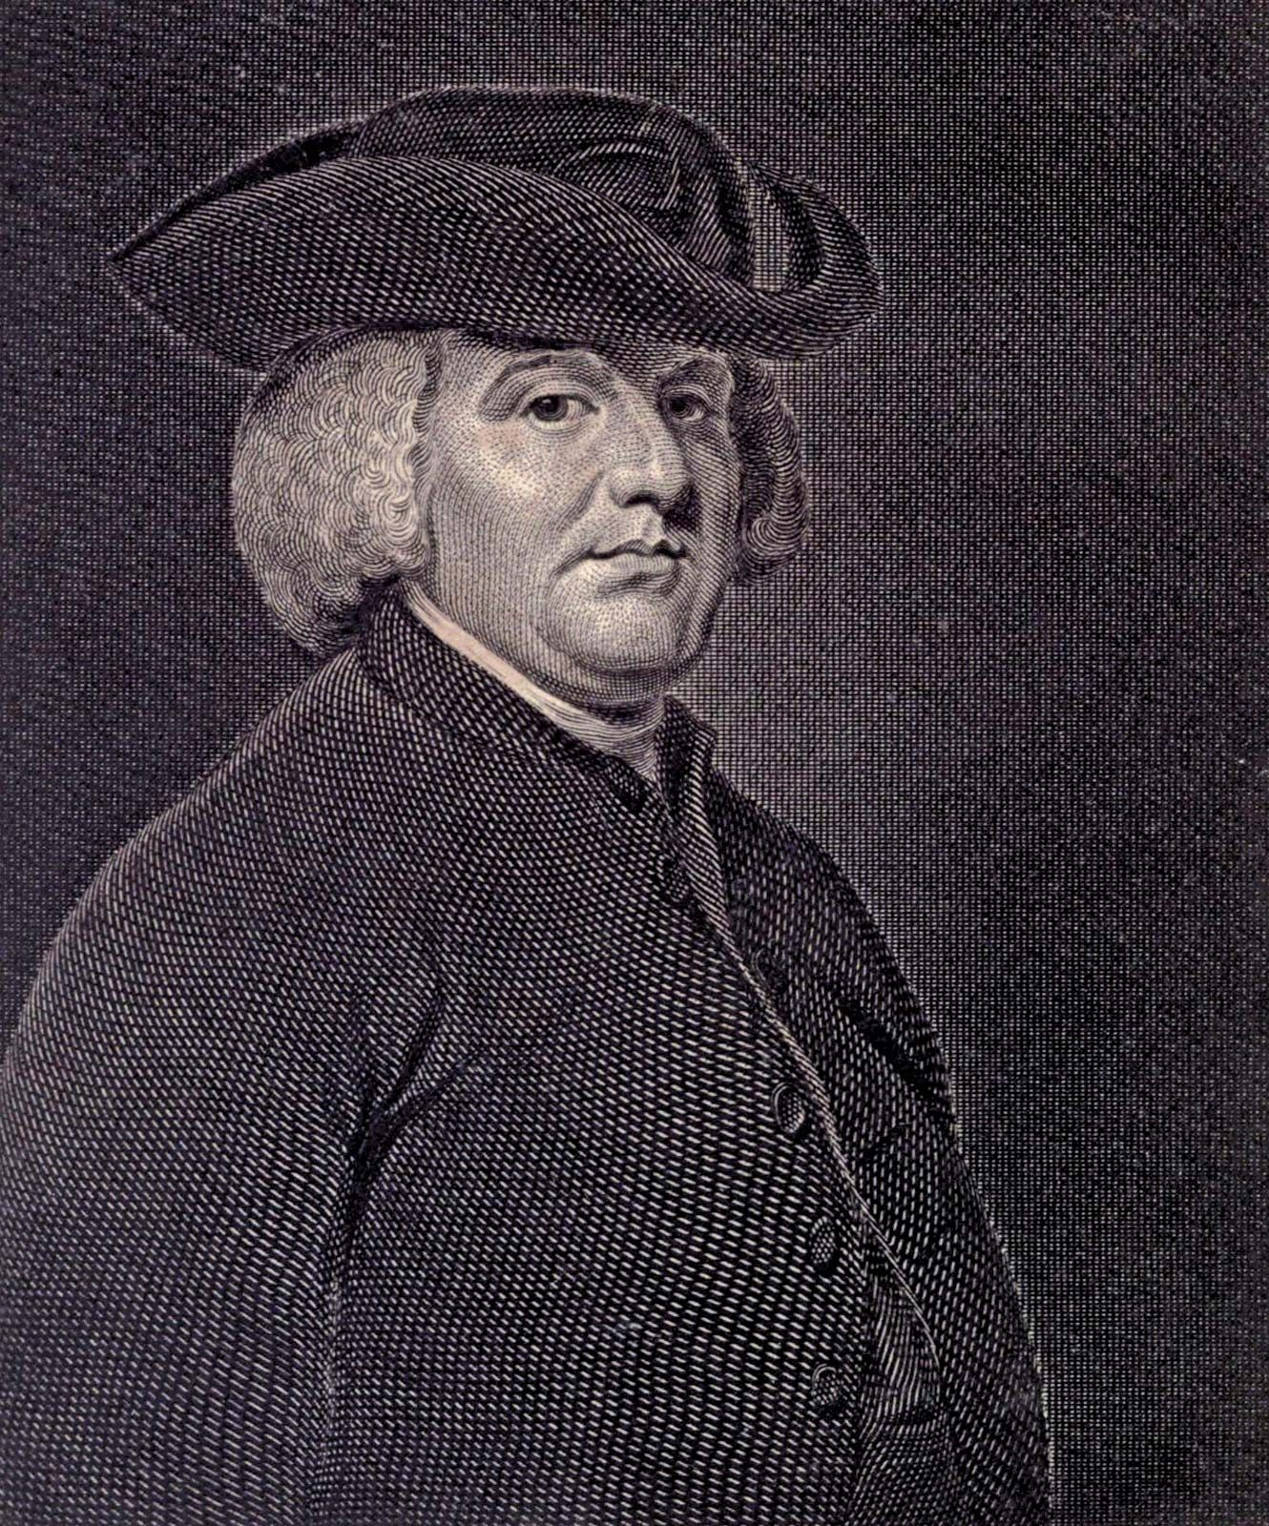
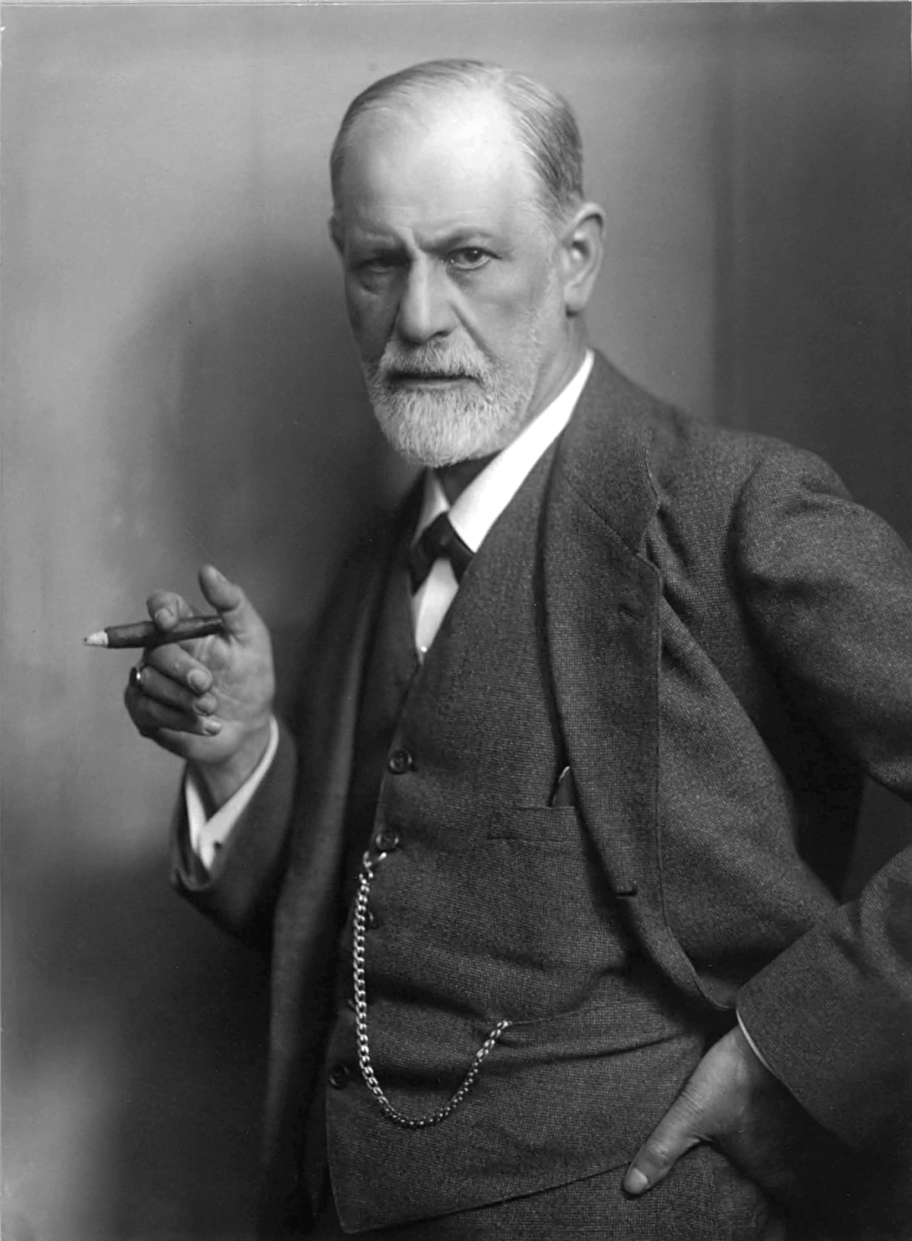
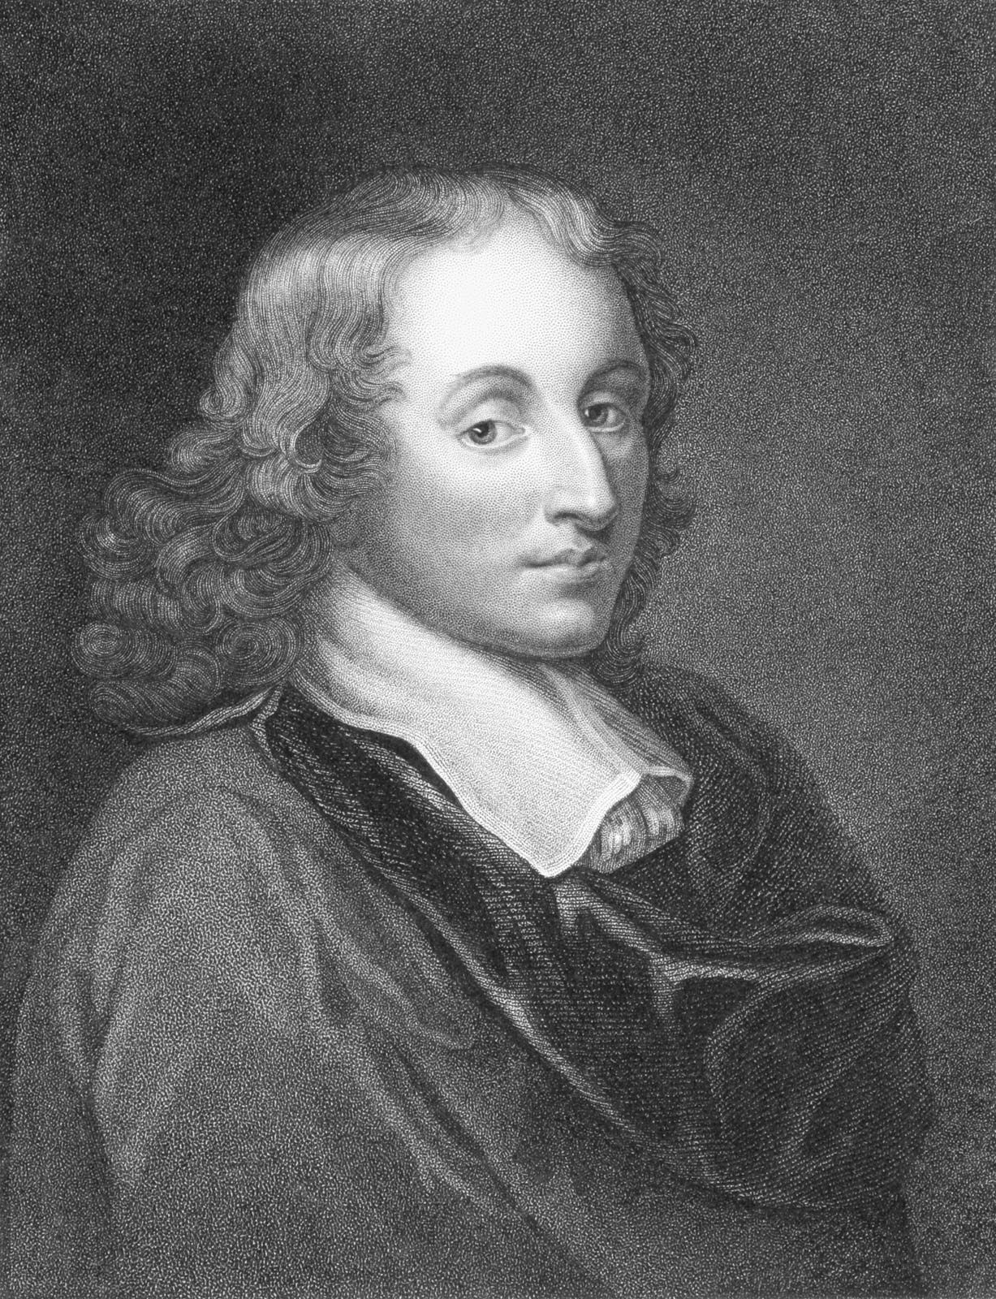
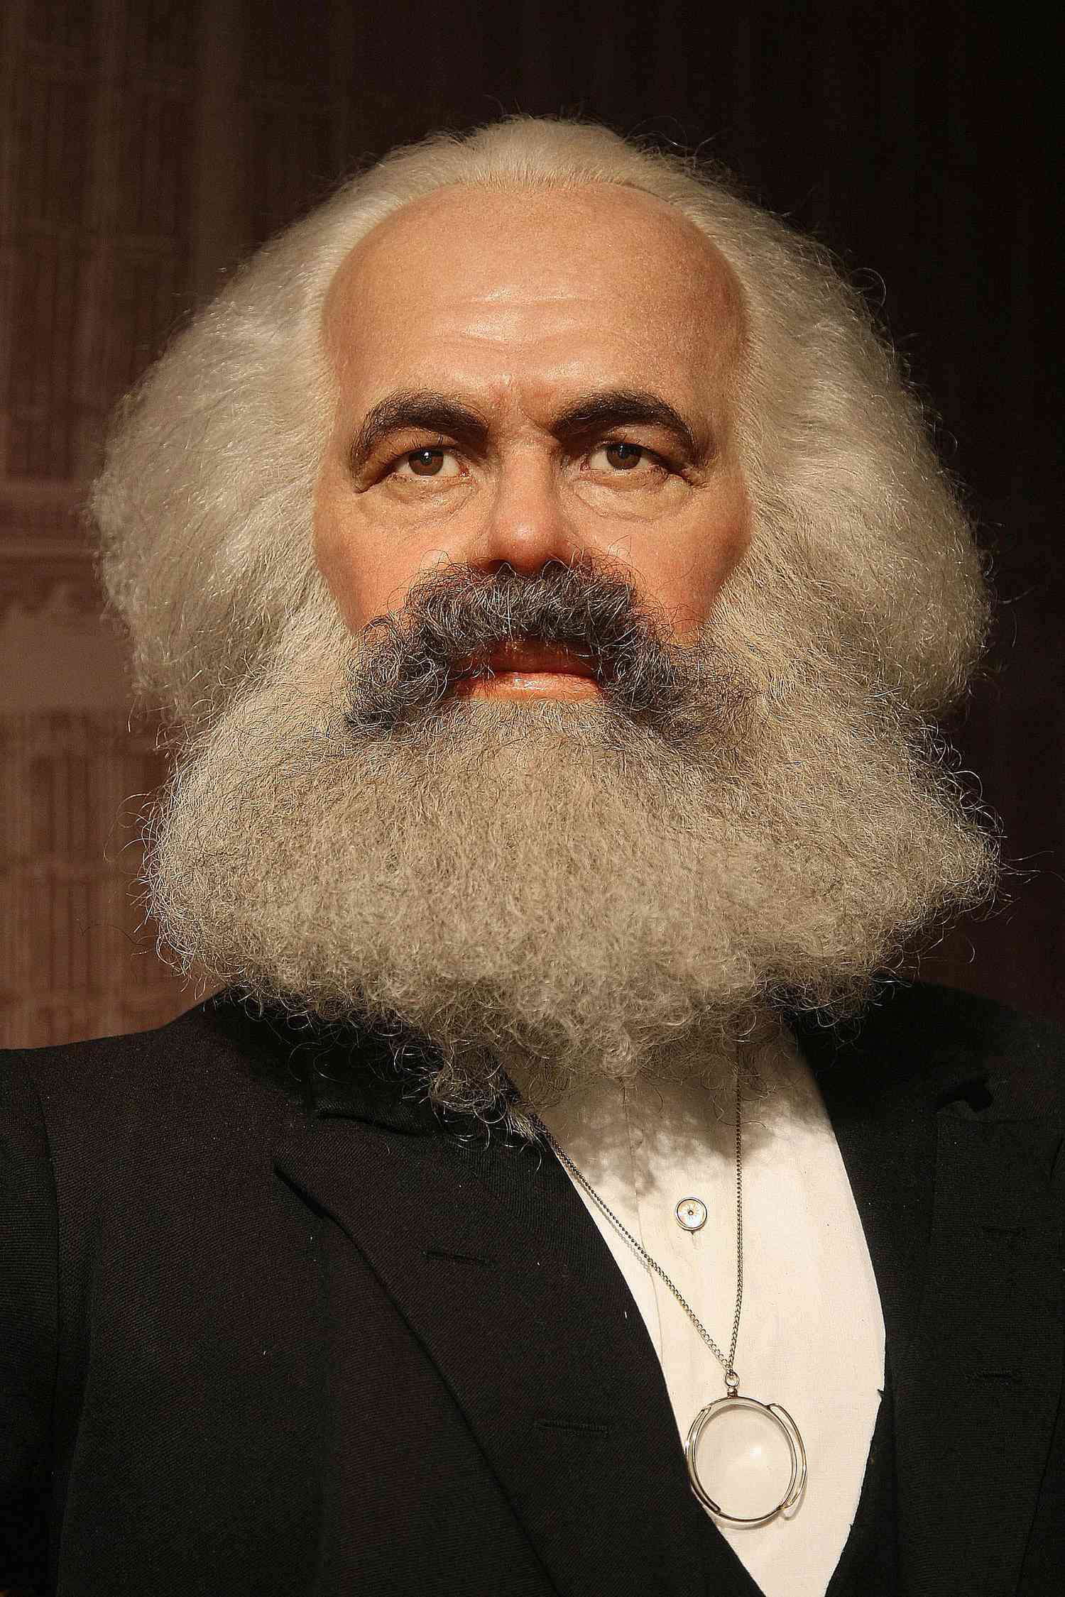
Plato 428 BCE
St. Thomas Aquinas 1225
Plato used the analogy of the cave to explain that humans easily accept their reality and that they are chained in by their limited understanding and do not question what they experience.
Humans do not look beyond their senses. But once they break out of their comfort zone and escape from the cave they will realise that things in the physical world are as flawed.
Thomas Aquinas believed that there was lots of evidence to suggest God exists, and that people are not naturally evil but we are all born good, we just sometimes make bad decisions.
Everything in the universe has a cause.
If everything in the universe has a cause, the universe itself must have a cause.
The cause of the universe must be God
William Paley 1743
Sigmund Freud 1856
Sigmund Freud described religion as a 'mass delusion' and tried to give a natural explanation as to why people believe in God. He suggested that everyone has three specific desires or wishes, and that religion can help people to feel as though those desires are being met/ coming true.
The desire for a Father
The desire for fairness
The desire for immortality
Key Philosophers and Scholars
William Paley used the design argument to try and prove that there is a God. He used the 'watch analogy’. He says you wouldn't come across a watch and see how the parts are made of different substances, different weights, colours texture etc. and yet see how all the parts work together to tell the time so precisely and think that this could have happened by chance. Paley says the universe is far more complicated than a watch and so we can not think that it just happened by chance.
Pascal's Wager 1623
Karl Marx 1818
Pascal Wager said that it is not possible to prove or disprove that God exists. Therefore, it is better to bet that he does. If God existed, and a person believed in God, they would be rewarded (with happiness forever); if a person did not believe, they would be punished (with what is called eternal damnation). If God did not exist it would make no difference. For this reason, it would be better to believe in God, Pascal said.
Karl Marx believed that religion allowed people to ignore reality. It becomes addictive for those who engage with it. He said it was a form of control, keeping the masses subdued (quiet). He said people lost their own identity to it and their ability to think logically

