Slide 1
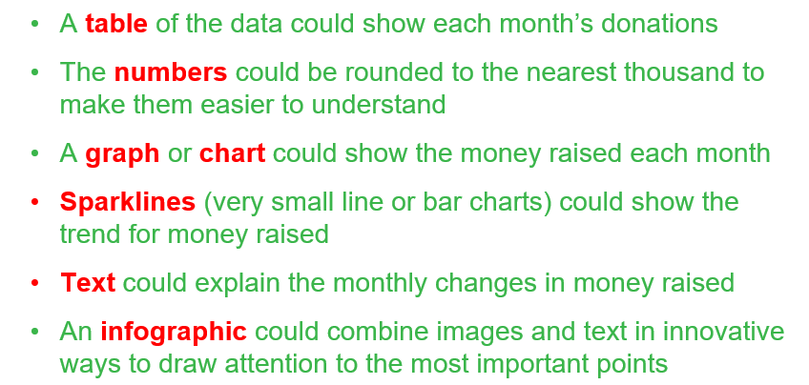
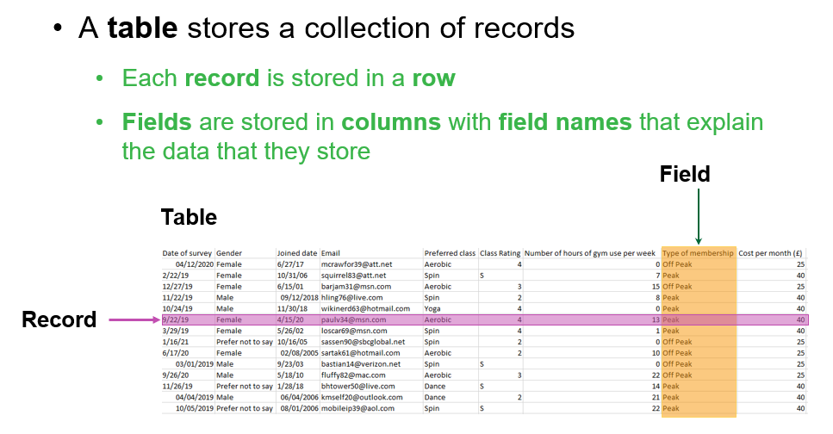

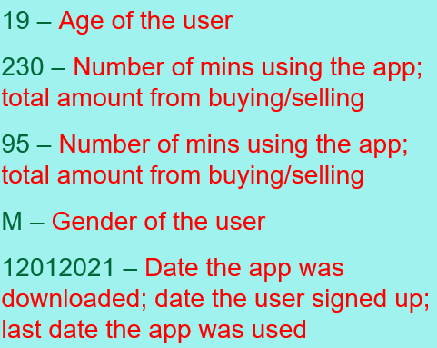
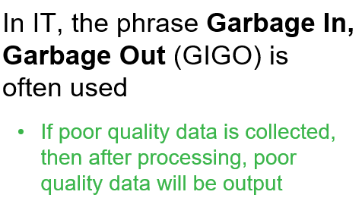
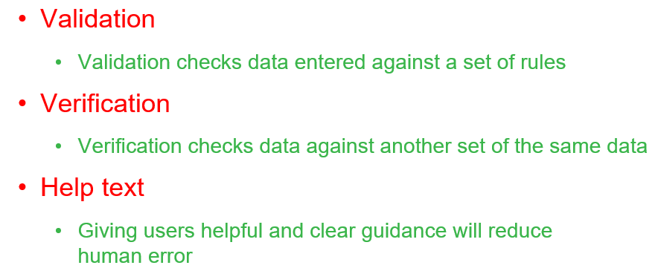
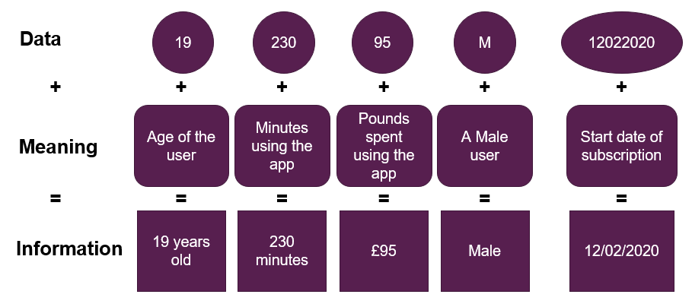
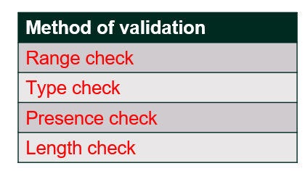
Knowledge Organiser: DIT Component 2 – Collecting, Presenting and Interpreting Data.
What is Data?
Data is Raw Facts and Figures (they have no meaning because they are without context).
Data Source
This is where the data has been collected from. E.g.:
  Paper joining forms
  Friendly Fitness’ membership database
  An email survey from a research company
SpreadSheet – Tables, Records and Fields
Presenting Data
What is Information?
Information is data that has been processed to have meaning, structure and context.
GIGO:
Task:
Identify the Advantages and Disadvantages of each method of Presenting Data listed above.
Improving Data Quality:
Verification:
Proof Reading
Double Entry Verification
Task:
Explain (with examples) how each method of Verification works.
Data:
Primary Data
Secondary Data
Types of Validation:
Task:
Explain the difference between Primary and Secondary Data
Task:
Explain (with examples) how each method of validation works.

Slide 2
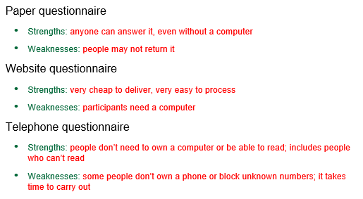
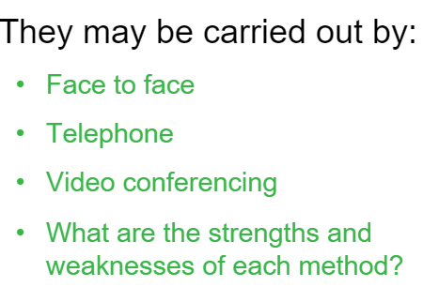
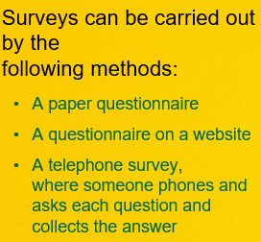
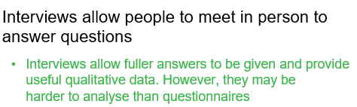
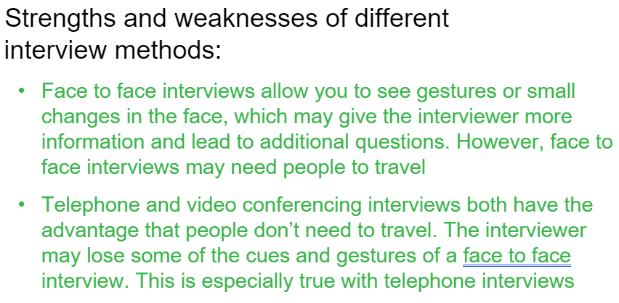
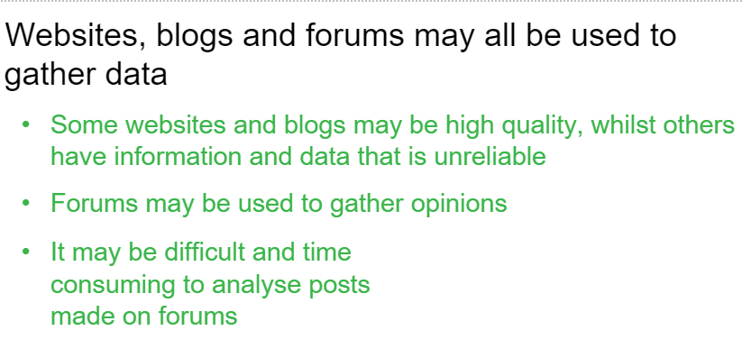
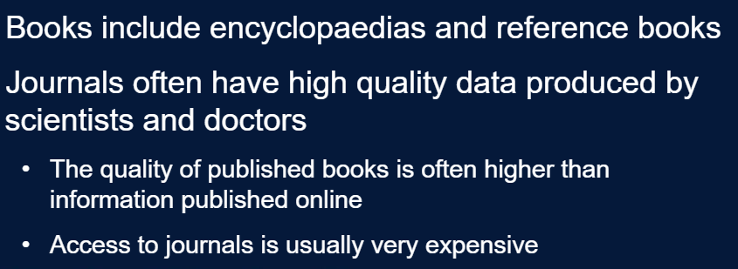
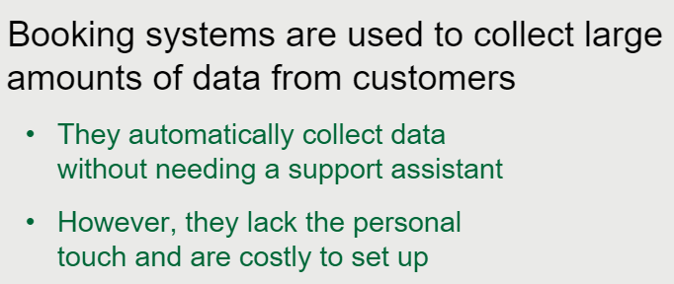
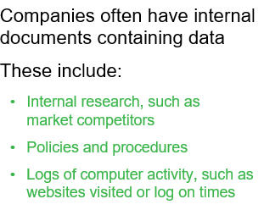
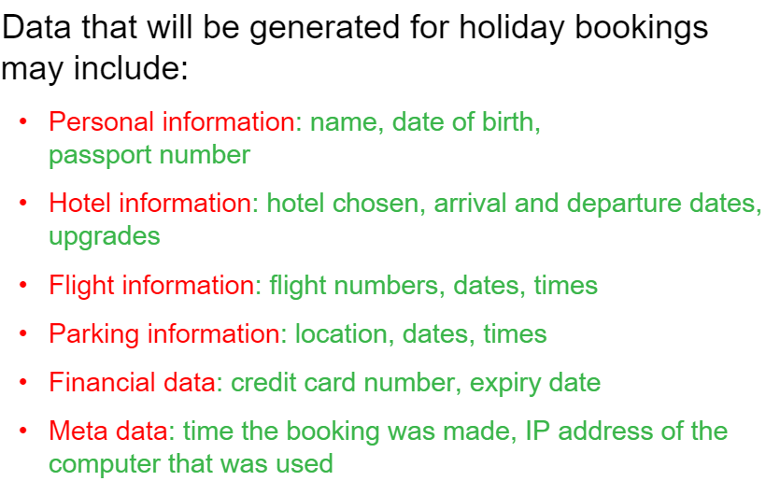
Methods of Data Collection?
Survey
Interviews
Books and Journals
Websites, Blogs and Forums
Booking Systems
Company internal documents

