Slide 1
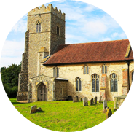
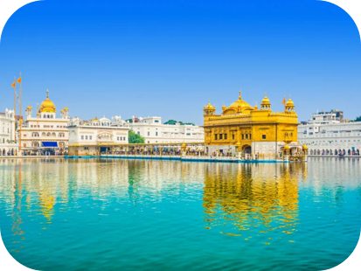
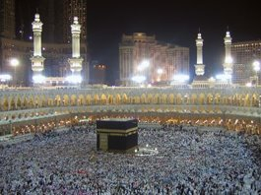
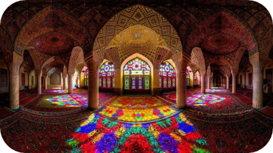
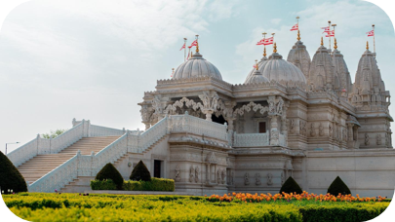
What is a special place?
Everyone has a place that is special to them- It could be somewhere that is really big and important to lots of people, or it could be really small and individual- Each one is as important as each other! Religions have lots of special places but we’re going to focus on two types in particular:
Keywords
Secularism | Being unrelated or completely neutral in terms of religion. Some people think all institutions should be secular.
Religious Pluralism | A society that allows lots of different religions to coexist. This also applies to different groups or denominations within a singular religion. (For example, Catholics; Protestants; Mormons; Baptists)
Culturally religious | Observing certain parts of a religion, such as festivals, family celebrations, or moral code, without necessarily believing in the spiritual part of the religion. (For Example: being ethnically Jewish; Cultural Hinduism)
Places of Worship
A specific space where people of a religion gather to worship together, learn about their faith, and interact with their community
For Example: A Gurdwara
Places of Pilgrimage
A place that religious people travel too as a sign of devotion to their faith. Often a very spiritual journey.
For Example: Mecca in Saudi Arabia

Slide 2

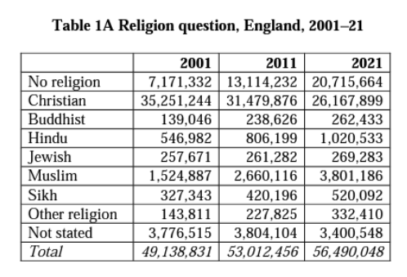
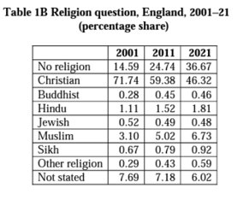
Census Data

